Slide 1
Text Sentiment Classification Pipeline

Slide 2
OBJECTIVE
Build an end-to-end
machine learning pipeline
for text sentiment classification
(Crypto News)
Decomposition
end-to-end pipeline
  Raw Data, Data Engineering, Modeling, Orchestration, Deployment, Serving, Visualization
machine learning
  Machine Learning, Deep Learning, LLM
text sentiment classification
  Classification Problem, Supervised Learning, Unsupervised learning

Slide 3
CONSULTANT PERSPECTIVE
Problems and Assumptions I
Business Perspective
  Cryptocurrency news
  Sentiment analysis
  Data-driven trading decisions
Challenges
  Crypto news is high-volume and unstructured
  Stakeholders struggle to quantify market sentiment

Slide 4
CONSULTANT PERSPECTIVE
Problems and Assumptions II
Technical perspective
  Data: quality, types, structures, distribution, lifecycle
  Model: accuracy, interpretability, scalability, rapid deployment, cost, lifecycle
  Hosting and Serving: local, cloud, platform, tool
  Visualization: tools, compatibility, scalability, and rapid implementation
Challenges
  Trade-offs between time, cost, and quality

Slide 5
CONSULTANT PERSPECTIVE
Problems and Assumptions III
Analytical perspective
  Crypto market sentiment trends?
  Are there sentiment shifts by cryptocurrency?
  Do different news sources show systematic bias?
Challenges
  Gain meaningful insights from multiple dimensions and multiple granularities

Slide 6
Architecture Design
Pipeline
  Data Ingestion
  Data Preprocessing
    Cleansing
    Feature Engineering
  Modeling & Model Selection
  Model Tracking and Management
  Hosting
  Serving
  Visualization
High standards
  Modular and extensible pipeline
  Clear separation of concerns
  Single orchestration entry point

Slide 7
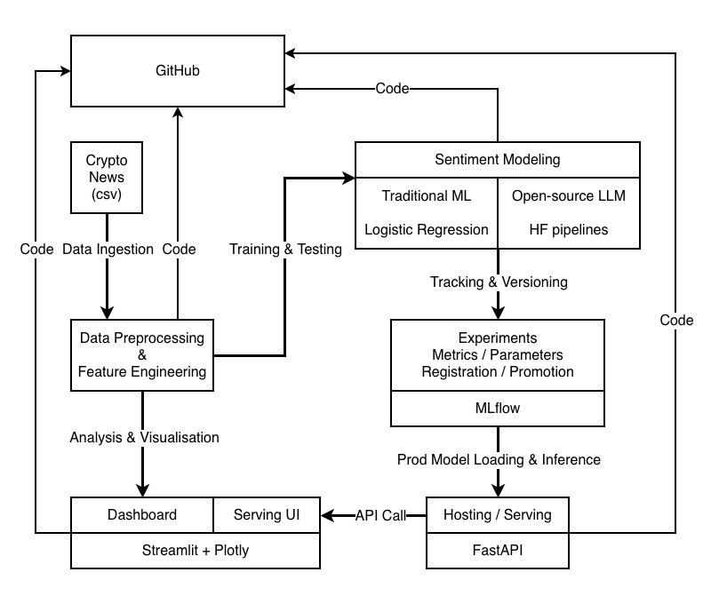
Architecture Design

Slide 8
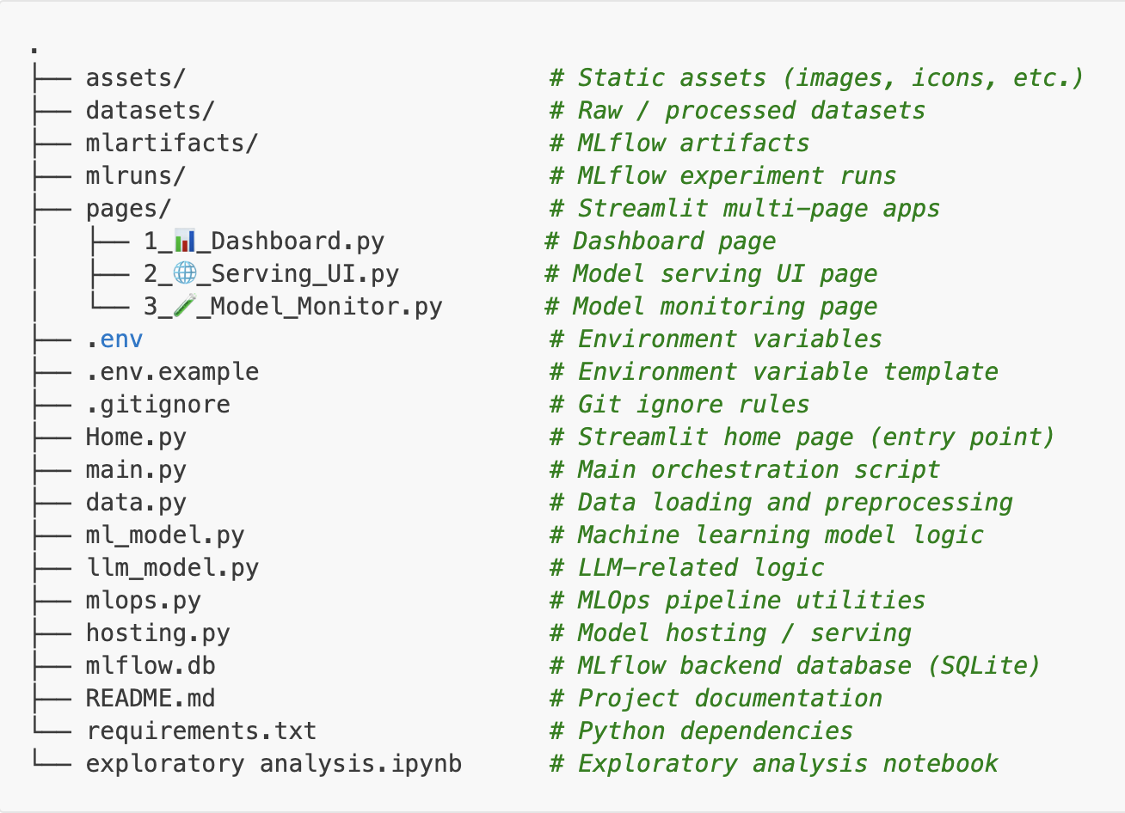
Project Structure

Slide 9
Data
Crypto News CSV dataset
Exploratory data analysis
  Data understanding
  Data preprocessing
  Feature engineering
  Imbalanced distribution
Class Imbalance Handling
  Moderate class imbalance
  Stratified splitting
  Class-weighted Logistic Regression
  Macro-averaged evaluation
Data-driven modelling strategy

Slide 10
Modelling
Rapid prototyping strategy
  Multi-class classification: negative / neutral / positive
  30k+ rows
  X = title + text, y = class (label)
  Low cost, high interpretability
Traditional ML as the baseline
Open-source LLM (pre-trained model) if time permits
Production-level delivery

Slide 11
Traditional ML
TF-IDF feature extraction
Logistic Regression
GridSearchCV for tuning
Sklearn has a built-in training pipeline

Slide 12
Open-source LLM
Hugging Face sentiment pipeline
Quick build
Pre-trained model
Inference-only evaluation
Batch inference supported

Slide 13
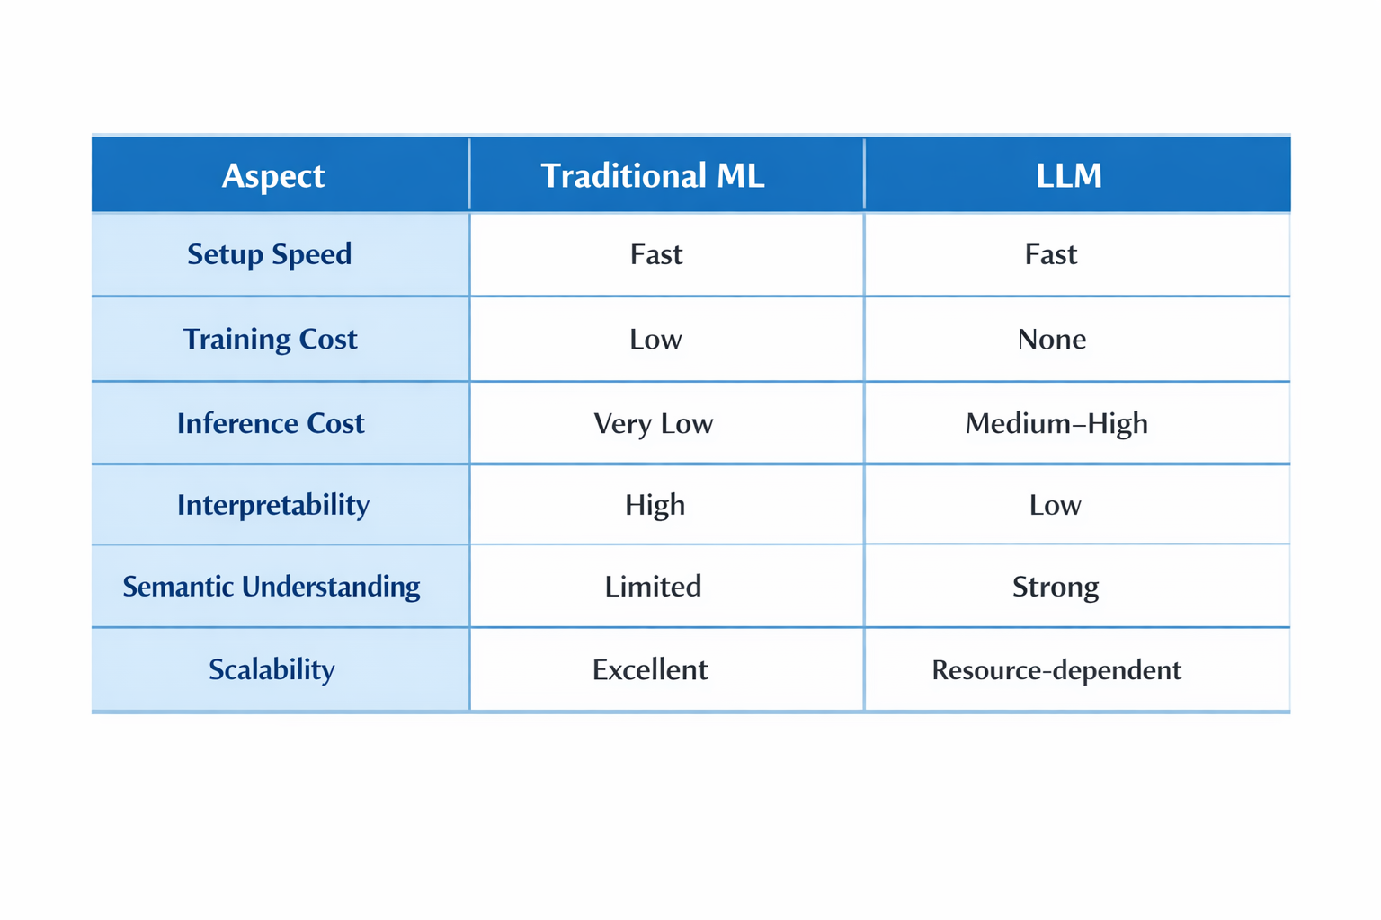
Model Comparison

Slide 14
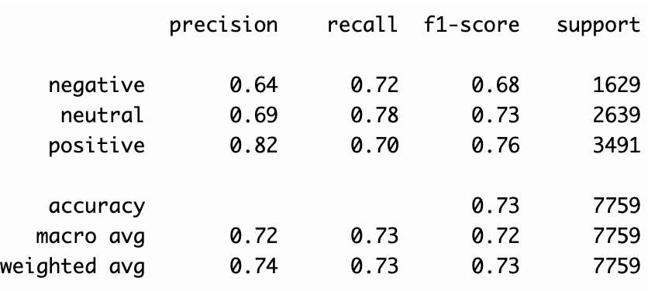
Evaluation Strategy
macro F1-score for imbalanced data
  Accuracy can be misleading. It is dominated by the majority classes.
  High precision may result from conservative predictions
  High recall may come from over-predicting a class
  Weighted F1 still favors majority classes
  Macro F1 treats all classes equally
  Each class contributes equally regardless of size
  Prevents majority classes from masking minority-class errors

Slide 15
MLOps
Experiment Tracking
  MLflow for experiments and artifacts
  Reproducible runs
  Model lineage tracking
Model Registry & Promotion
  Best models registered
  Automatic promotion to production alias
  Metric-driven decisions

Slide 16
Pipeline Orchestration
main.py as pipeline controller
Mutually exclusive ML / LLM modes
Shared data preparation logic

Slide 17
Model Serving
FastAPI-based local serving
Health, status, and prediction endpoints
Stateless inference service

Slide 18
Visualization & Monitoring
Streamlit dashboards
Sentiment trends and breakdowns
Model comparison and latency insights

Slide 19
Limitations
Due to time constraints:
No automated testing
Local-only deployment
No domain-specific fine-tuning
Hybrid approach not yet implemented

Slide 20
Summary
End-to-end production-oriented pipeline
Multiple modelling paradigms
Robust MLOps
Local hosting & serving
Interactive visualization and monitoring
Well-defined trade-offs and assumptions

